Slide 1

Modern Control Theory
Lecture No. 13
Conceptualizing the Kalman Filter
Minimizing the Covariance
Obtaining the Kalman Gain
Formulation of the Kalman Filter

Slide 2
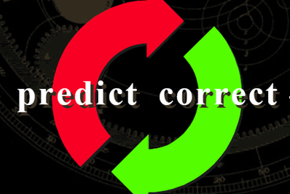
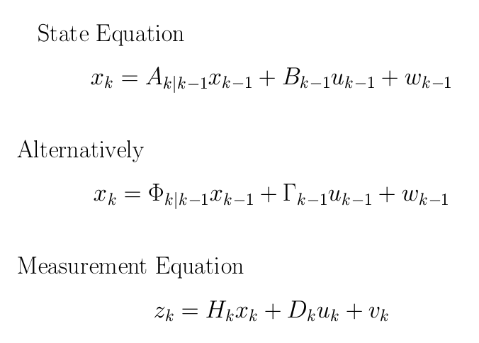
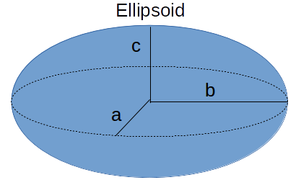
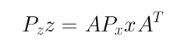
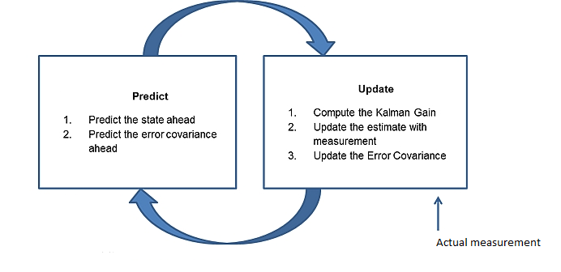

Understanding the Prediction & Update Process/ Steps
Update
Prediction of the State
+ Q
(k-1)+
(k)-
(k)+
k-1
k
z(k-1)
z(k)

Slide 3
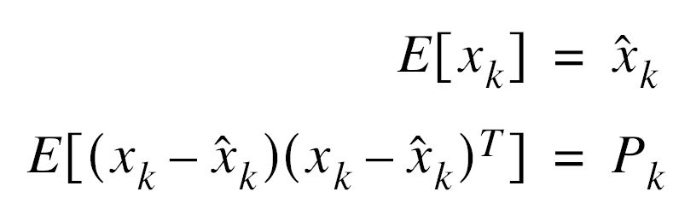
An Optimal State Estimator
Estimating the State
Minimizes the Error
Obtaining the Mean & Covariance

Slide 4
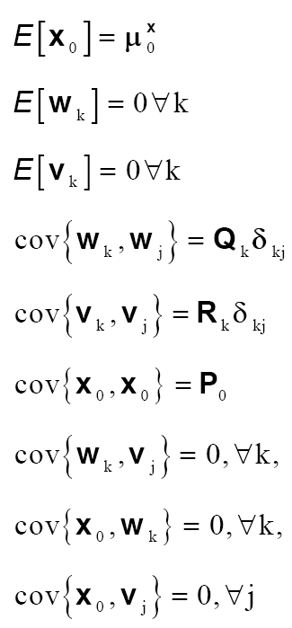
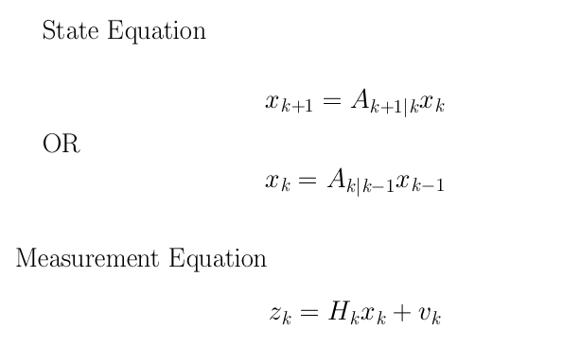
Deterministic & Unforced Dynamical System
Assumptions

Slide 5





Prediction & Update
Update
(k-1)+
Prediction
(k)-
(k)+
k-1
k
z(k-1)
z(k)

Slide 6
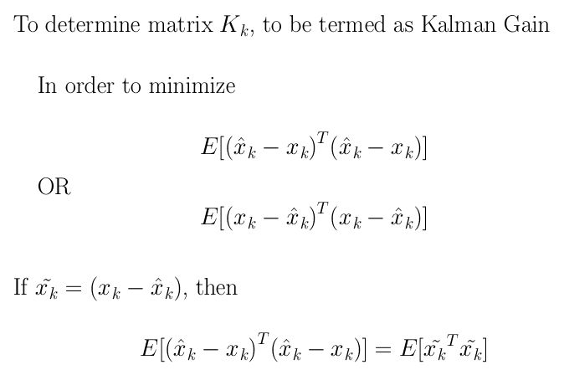
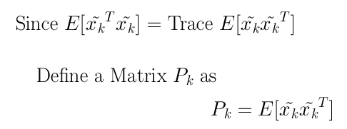
Kalman Gain & Covariance

Slide 7
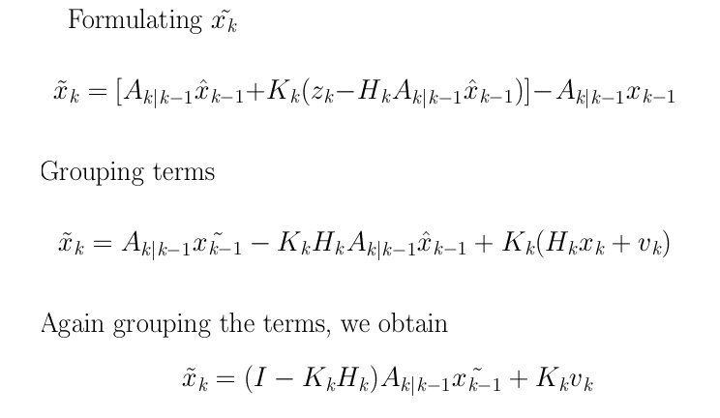
To Obtain the Expression for Covariance
Step 1 :

Slide 8



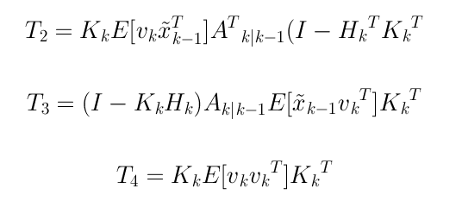
Obtaining the Covariance Matrix
Step 2 : Expanding the term

Slide 9
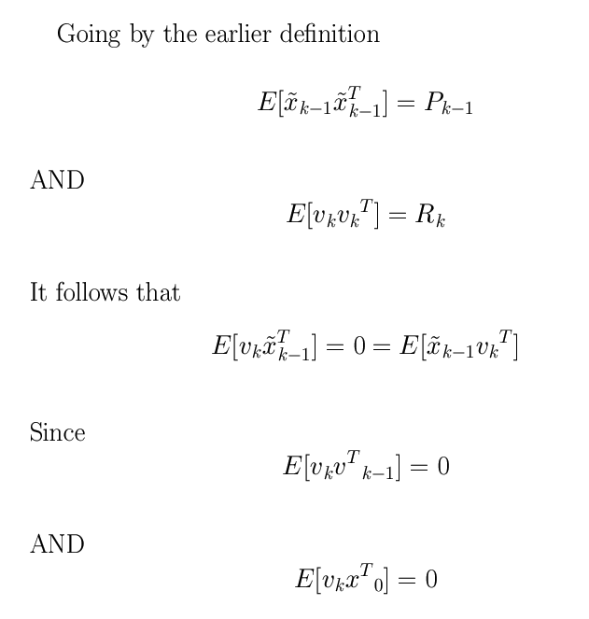

Slide 10
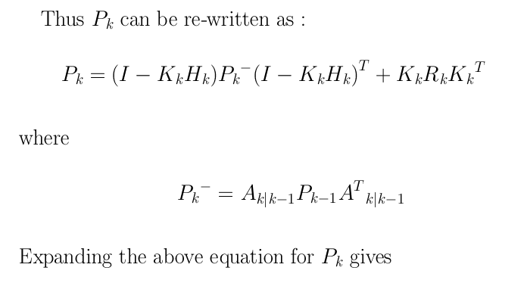
Obtaining Apriori P

Slide 11




Obtaining K

Slide 12
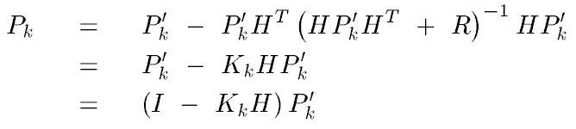
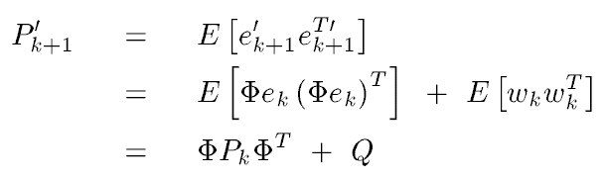
Obtaining the P Matrix

Slide 14
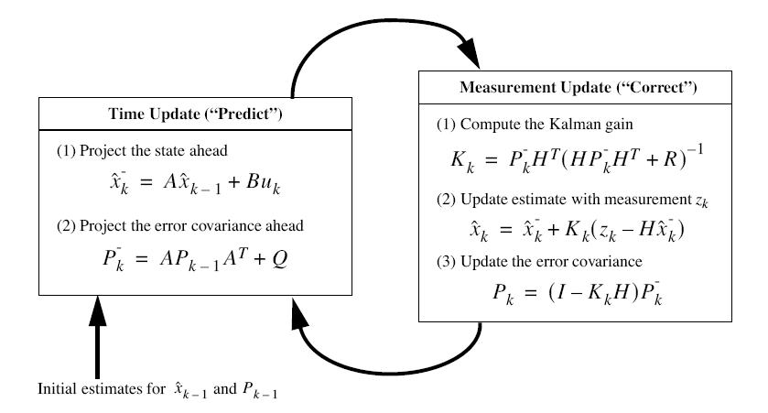
The Kalman Filter

